Slide 1
Kolk, A., Henseler, J. F., Witte, P. D., Zwet, E. V., Zwaal, P. V., Visser, C., . . . Groot, J. D. (2017, June). The effect of a rotator cuff tear and its size on three-dimensional shoulder motion. Elsevier, 45, 43-51.
Kolk, A., MD, Witte, P. D., PhD, Henseler, J. F., MD, Zwet, E. V., PhD, Arkel, E. V., PhD, Zwaal, P. V., PhD, . . . Groot, J. D., PhD. (2016, June). Three-dimensional shoulder kinematics normalize after rotator cuff repair. Elsevier, 25(6), 881-889.
Kolk, A., Henseler, J. F., De Witte, P. B., Arkel, E. V., Visser, C. P., Nagels, J., & Nelissen, R. G. (2016, July 11). Subacromial anaesthetics increase asymmetry of scapular kinematics in patients with subacromial pain syndrome. Elsevier, 26, 31-37.
Henseler, J., MD, Kolk, A., MD, Zondag, B., BEng, Nagels, J., MD, Groot, J. D., PhD, & Nelissen, R., MD. (2016, November). Three-dimensional shoulder motion after teres major or latissimus dorsi tendon transfer for posterosuperior rotator cuff tears. ScienceDirect, 26(11), 1955-1963.

Slide 2
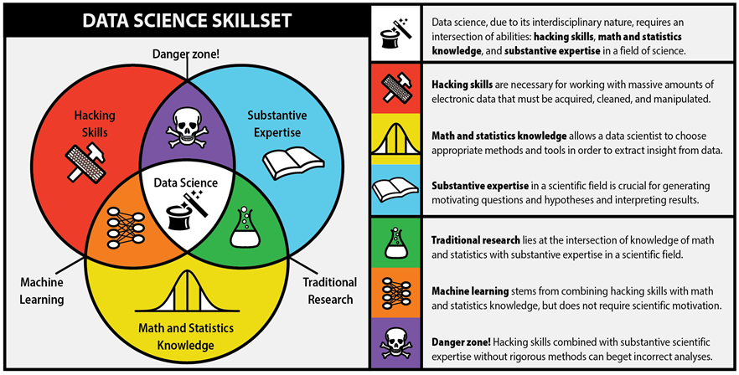

Slide 3
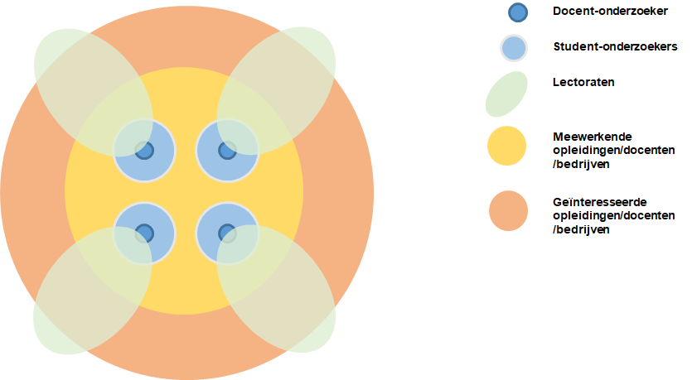
KB-74 is a very cool experiment
Real project, real data, real uncertainty
Project = (applied) research
We do not know the solution (yet)!
Lightly planned; learn as we go, what we need
Participation of a scientist:
Guidance
To ensure relevant and valid results
Work tightly together at the same table

Slide 4
Ortho Eyes
Tony Andrioli
Business IT & Management Applied Mathematics
Kasper van der Hoofd - Carlijn Konings
Vincent van den Oord - Rogier Zitman
Luke de Keizer

Slide 5
Background
Physiotherapists and doctors help with the recovery of patients after chirurgical procedures. To determine the optimal treatment for the patients it is important to measure the range of motion (RoM) of a patient’s limbs quickly and accurately.
Leiden University Medical Center has an ‘Flock of Birds’-system that can accurately measure the RoM of a patient’s limbs. The system is used for research but the system was never used to determine a patient’s current medical condition because it isn’t certain this is possible.
Other research papers also suggest researching the RoM of a patient’s limbs for diagnostic purposes:
“Due to our cross-sectional study design, future studies should investigate whether kinematic analyses of shoulder motion are useful for diagnostic purposes. A next step in our research would be to investigate the kinematics in subjects without RC disease and to investigate how kinematics change during life.” (Kolk et al., 2017)
Notes:
Dikgedrukte woorden TO-DO: Patient Groups uitleggen
(3 slides
(uitprinten voor mezelf ( steekwoorden op de sheet

Slide 6
Background
It’s about:
recovery of patients with shoulder problems after chirurgical procedures
measurements of the range of motion (RoM)
the ‘Flock of Birds’-system of the LUMC that can accurately measure the RoM.
Other research papers suggest researching the RoM of a patient’s limbs for diagnostic purposes:
“investigate whether kinematic analyses of shoulder motion are useful for diagnostic purposes.” (Kolk et al., 2017)

Slide 7

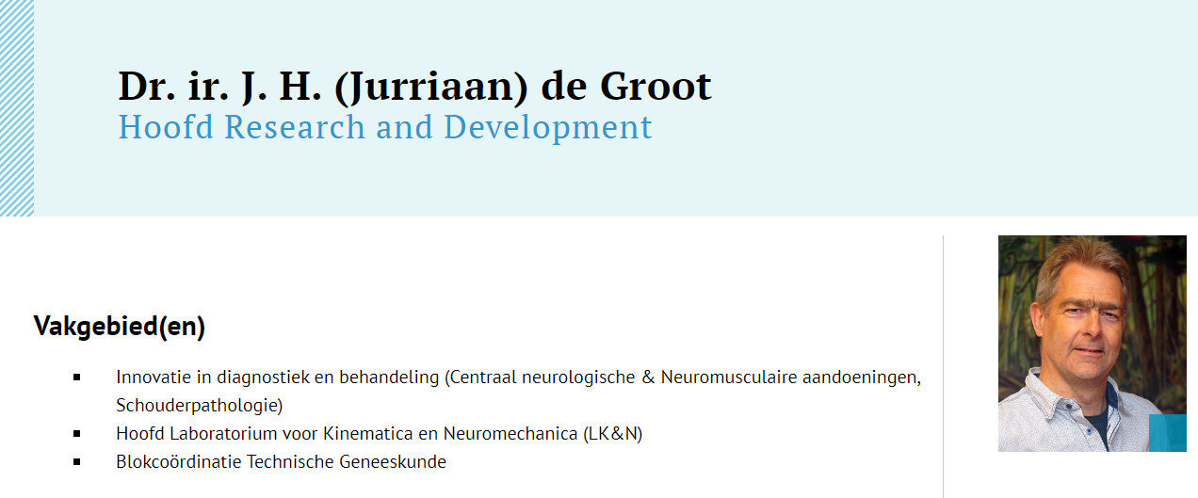
Our Client

Slide 8
The project
Project goals:
Is it possible to:
Find patterns and/or structures
Determine a patient’s groups
From the data of measurements made by the ‘Flock of Birds’-system
For us as students to learn as much as possible about data-science
Notes:
Patient groups uitleggen

Slide 9
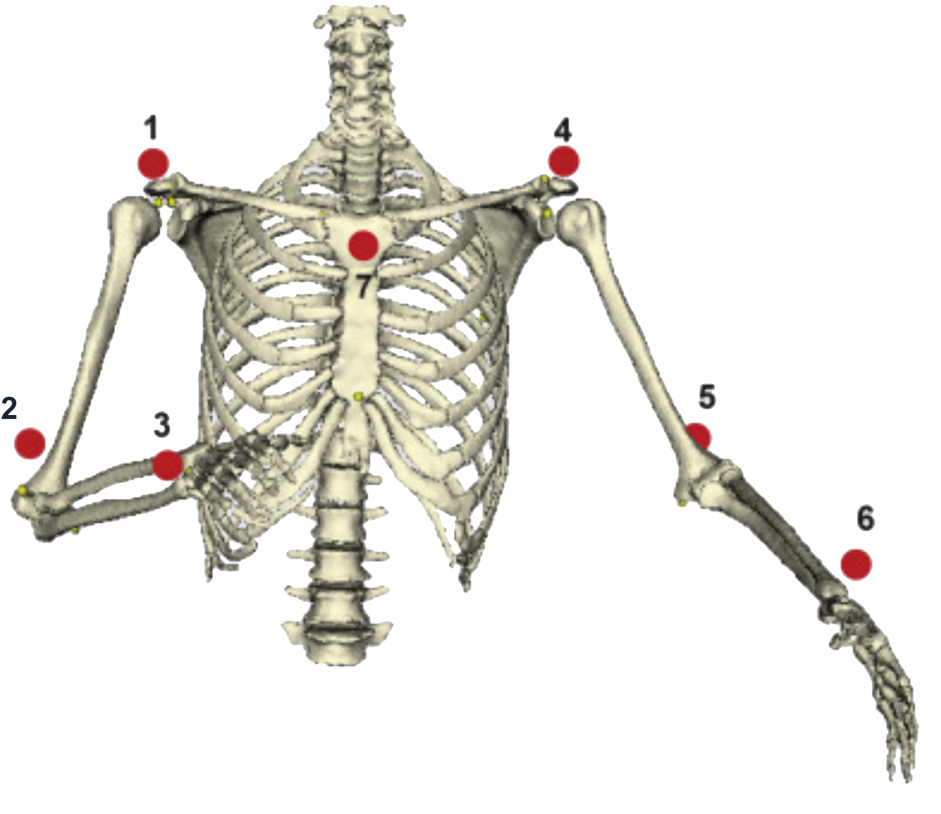
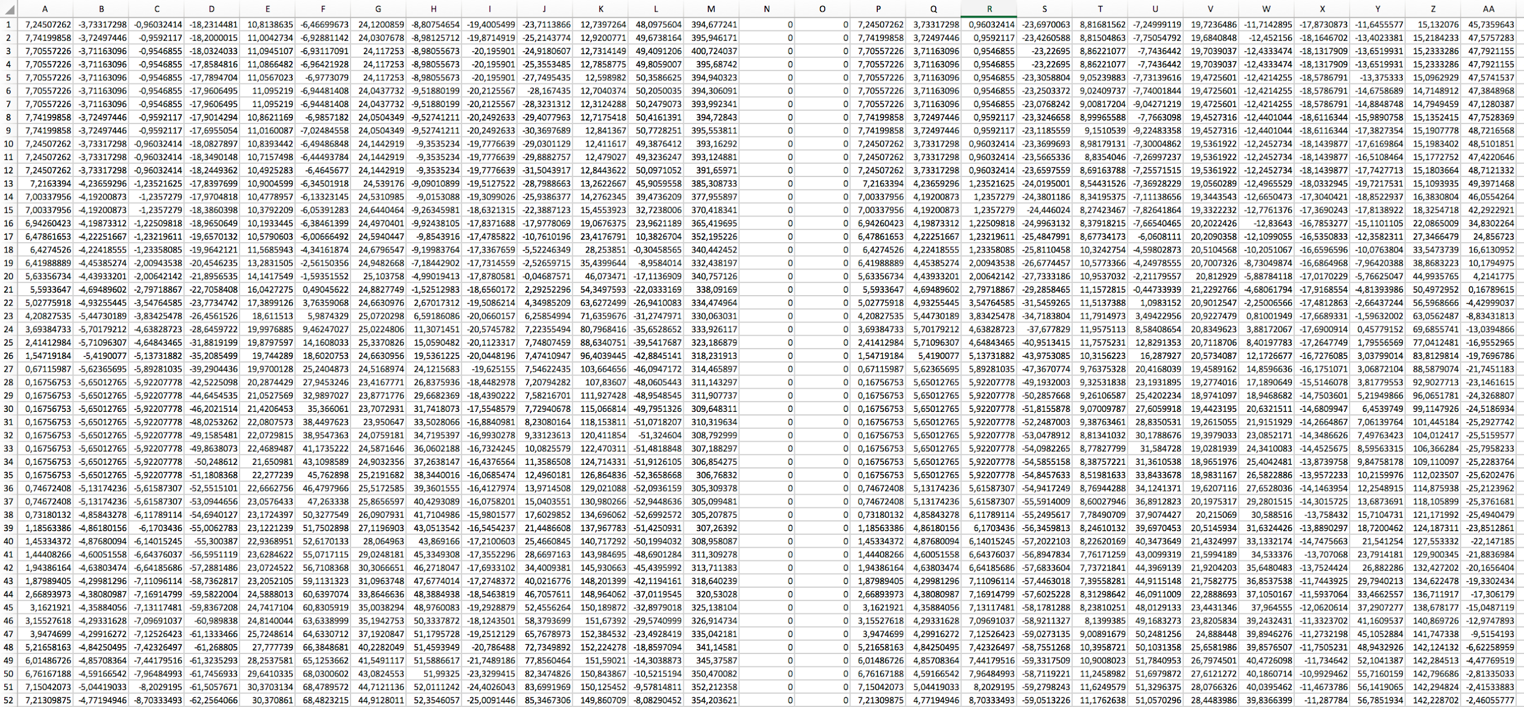
The project
The Leiden University Medical Center’s ‘Flock of Birds’- system
1 measurement = (30 x 107 rows)

Slide 10
What have we achieved?
Practiced Python with DataCamp
Set up an project environment: (Trello, GitHub, Google Drive, WhatsApp)
Gained insight about context and goal of project by reading literature
Received a first data sample

Slide 11
What have we planned?
Filling a first product backlog
Continuing the DataCamp courses
Receiving the full data-sets
Reading more literature to gain more insights in the context

Slide 12
The problems we face or expect to face
Our client is very busy
Difficult and time-consuming literature
Unfamiliar with medical jargon
Insufficiënt knowledge about structure of data

Slide 13
A question for you..
Notes:
Does anyone know something about euler angles?

Slide 14
Any questions or suggestions?

